Slide 1

Fitness Tracker System
Author: Aravind Praveen

Slide 2
Introduction
The Fitness Tracking Web Application provides a personalized fitness monitoring experience.
Integrates machine learning models for health insights.
Built using the Django framework.
Focus on user interaction and data analytics.

Slide 3
Objective
Develop a platform for fitness data input.
Utilize machine learning for fitness recommendations.
Store and visualize historical fitness data.

Slide 4
System Overview
Users can register, log in, and input fitness data.
Calculates BMI, BMR, TDEE, and step distance.
Provides fitness status (Fit/Not Fit) through ML model.

Slide 5
Technologies Used
Backend Framework: Django (Python)
Frontend: HTML, CSS
Database: SQLite
Machine Learning: Random Forest Classifier with Joblib
Other Libraries: Django Forms, Messages Framework

Slide 6
Modules and Functionalities
User Management: Registration, Login, Logout
Fitness Data Input: Height, Weight, Step Count, etc.
Fitness Analysis: BMI, BMR, TDEE, ML Predictions
Fitness History: Display and visualize historical data

Slide 7
Database Design
Field Name | Data Type | Description
User | ForeignKey | Links fitness data to a user.
Height | FloatField | User’s height (cm).
Weight | FloatField | User’s weight (kg).
BMI | FloatField | Body Mass Index.
Step Count | IntegerField | Number of steps taken.
Calculated Distance | FloatField | Distance based on step count
Sleep Duration | FloatField | Hours of sleep.
Stress Level | IntegerField | Stress level (0-2).
Hydration Level | FloatField | Hydration level (liters).
Activity Level | CharField | User’s activity level.
BMR | FloatField | Metabolic Rate.
TDEE | FloatField | Total Daily Energy Expenditure.
Status | CharField | Fitness status (Fit/Not Fit).
Message | TextField | Health-related feedback.
Created At | DateTimeField | Timestamp for data entry.

Slide 8
Machine Learning Integration
Model: Random Forest Classifier
Input Features: Height, Weight, BMI, Step Count, etc.
Output: Fitness Status (Fit/Not Fit)
Preprocessing: Data scaled using StandardScaler
Storage: Model and scaler saved as .pkl files

Slide 9
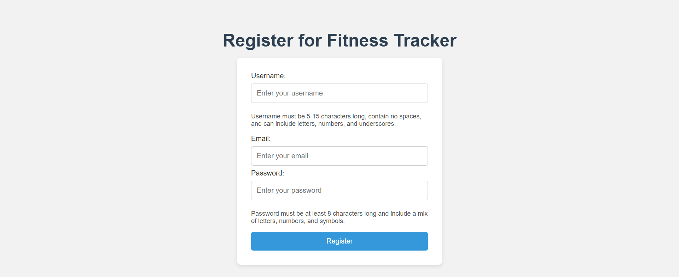
User Interface
Registration Page: Form for new user registration.

Slide 10
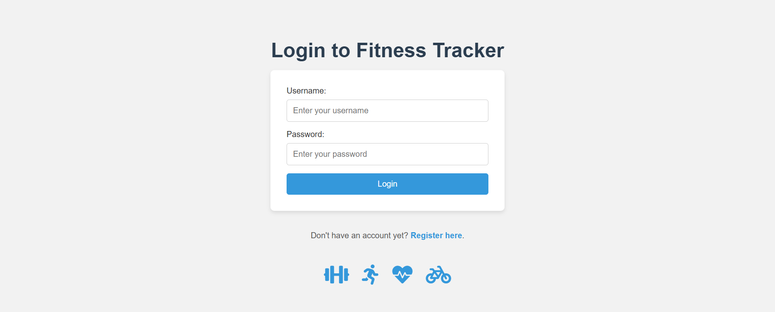
Login Page: Authentication for returning users.

Slide 11
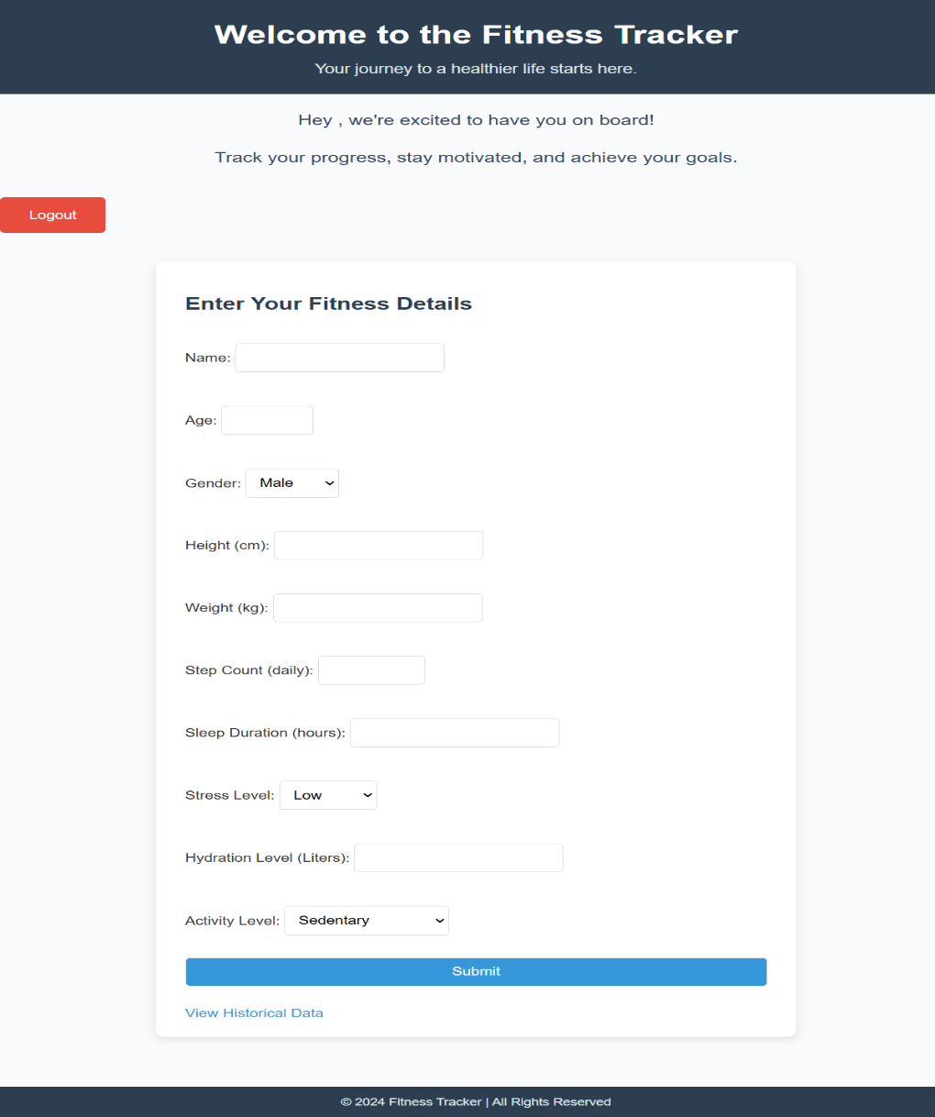
Fitness Form: Allows users to input fitness-related data.

Slide 12
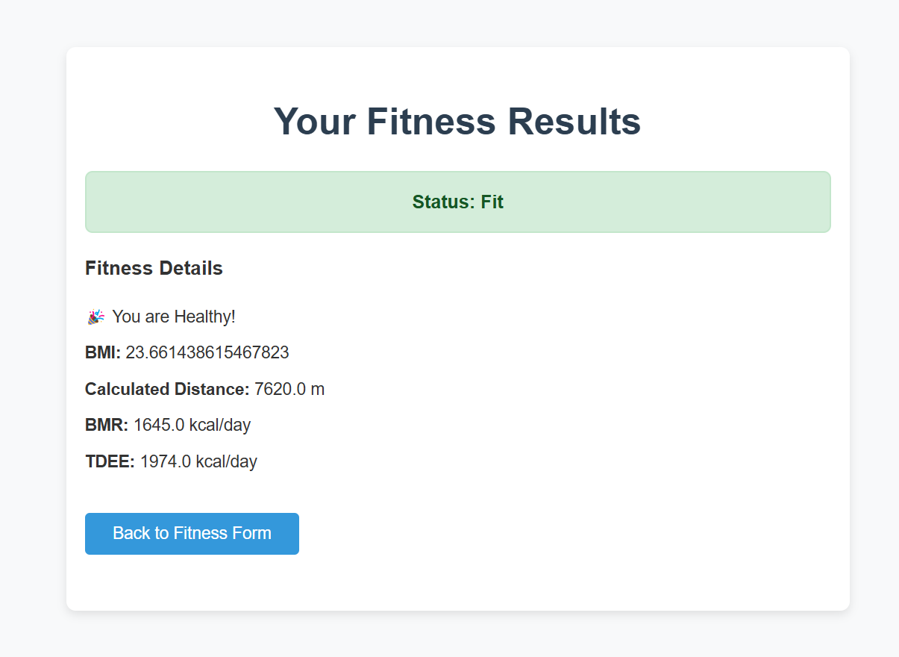
Results Page: Displays predictions and insights.

Slide 13
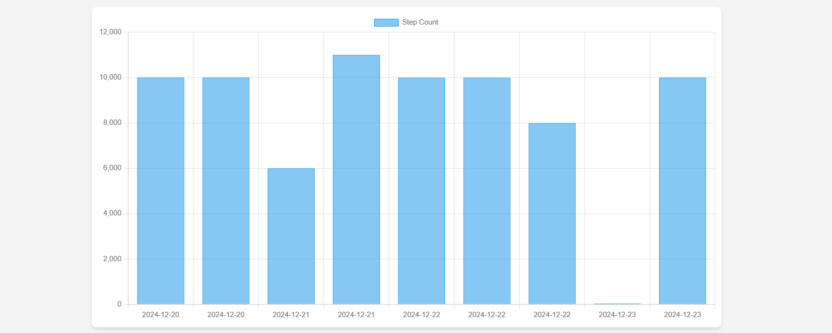
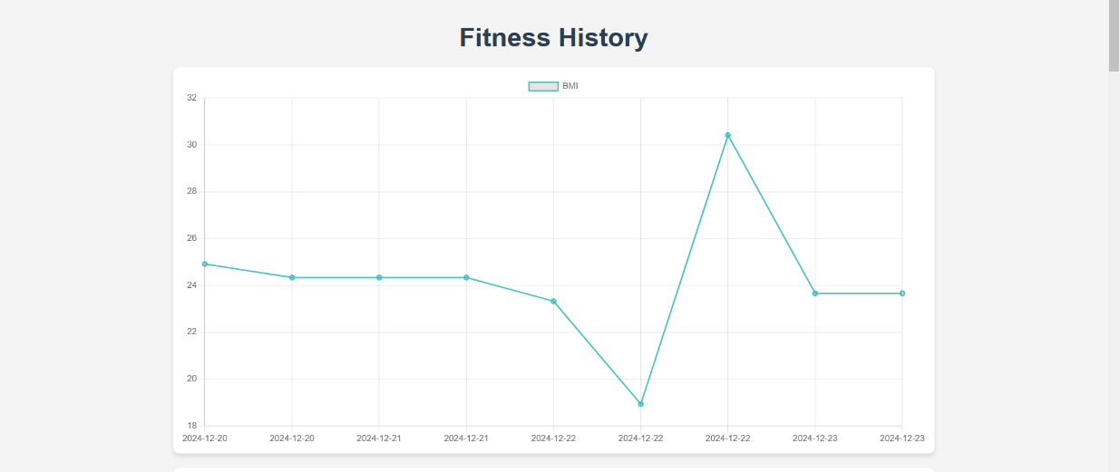
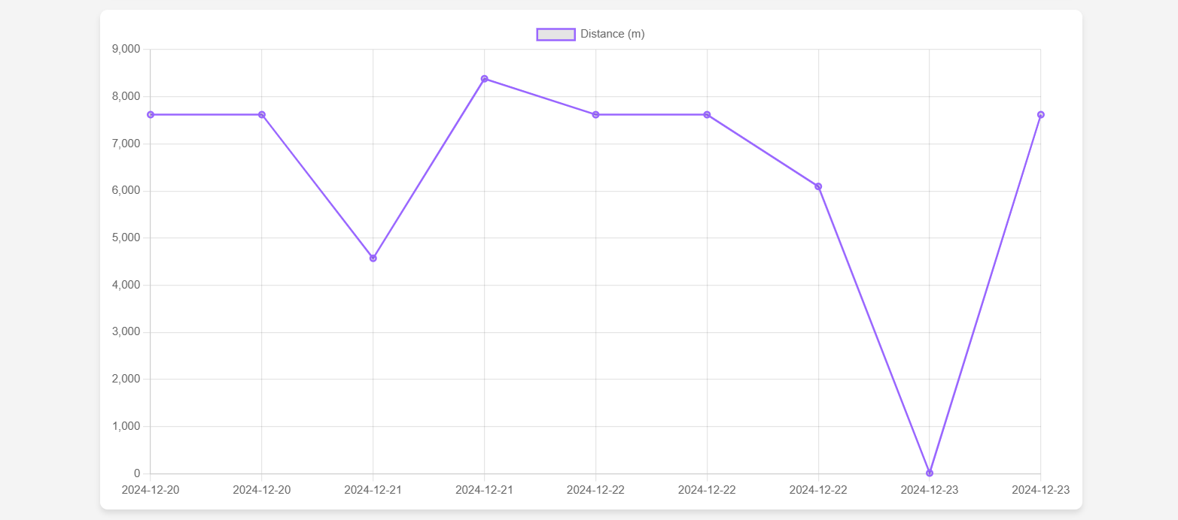
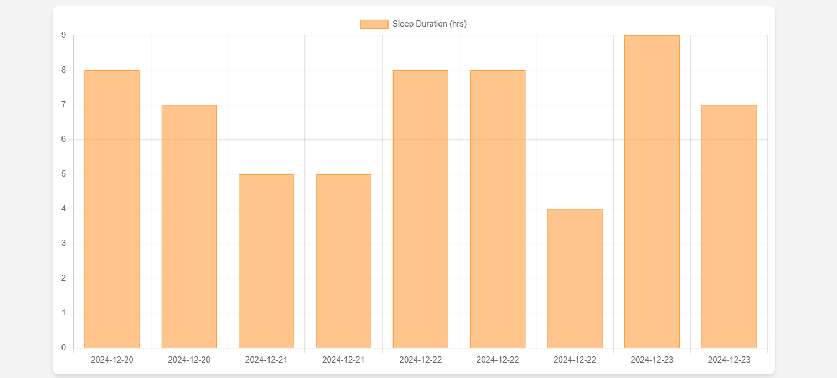
Fitness History: Visualizes historical data.

Slide 14
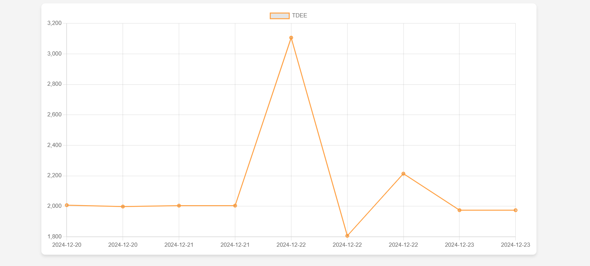
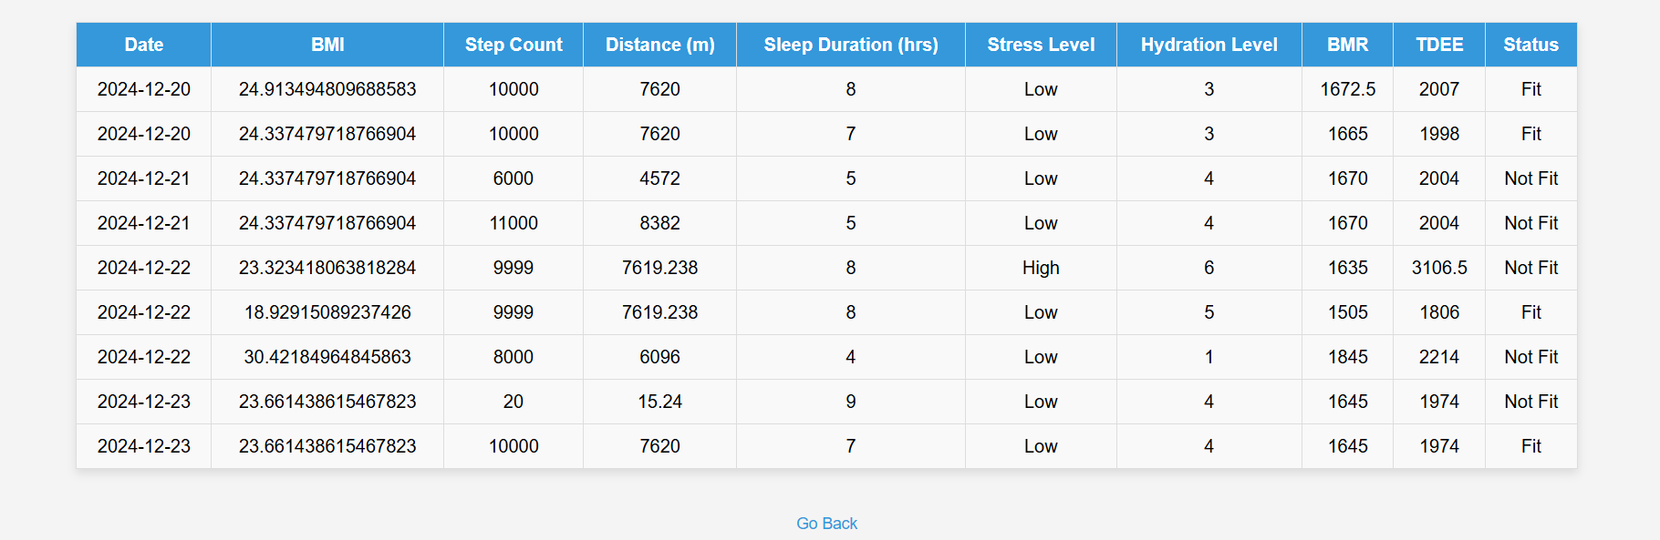
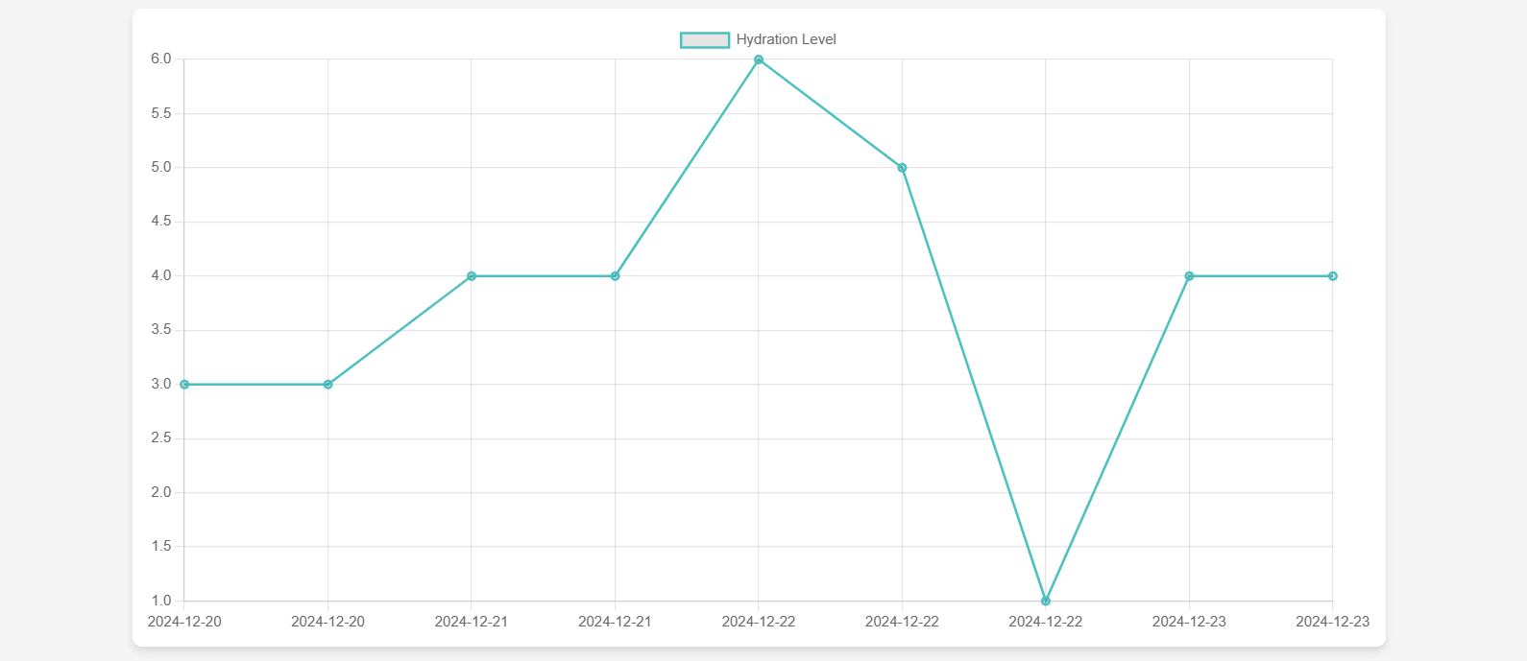
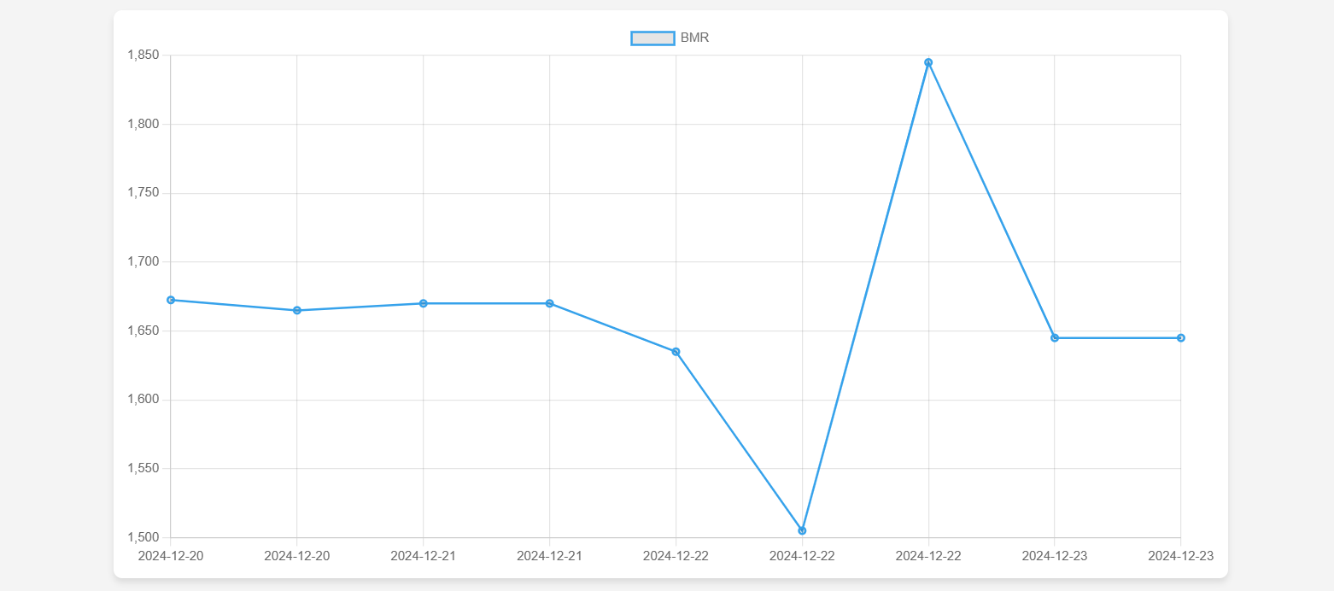
Fitness History: Visualizes historical data.

Slide 15
Testing and Validation
Unit Testing: Registration, Login, Data Saving
Integration Testing: Interaction between forms, database, and ML model
Validation: Model predictions against known inputs

Slide 16
Challenges and Solutions
Handling Invalid Inputs: Form validation
Model Integration: Standardized formats
Stress Level Encoding: Mapping stress levels to numerical values

Slide 17
Deployment
Platform: Railway
Steps: Setup, Environment Variables, Deployment, SSL, Performance Monitoring

Slide 18
Code Overview
Django Views: Request handling, data input, analysis, rendering
Machine Learning: Model loading, preprocessing, prediction
Forms: Data input and validation
Models: User and fitness data management

Slide 19
Conclusion
Integrates Django and machine learning for personalized fitness insights.
Enables users to track their fitness journey.
Provides actionable feedback to improve health.

Slide 20
Future Scope
Enhanced Predictions: Larger dataset for better accuracy
Data Visualization: Graphical representations of historical trends
Mobile App Integration: Companion app for easier data entry
Real-Time Monitoring: Wearable device integration

Slide 21

THANK YOU FOR YOUR ATTENTION

